Slide 1










Presented by :
angala parameswari.r
GLOBAL ECONOMIC AND DEMOGRAPHIC TRENDS ANALYSIS

Slide 2



HOME
ABOUT
CONTENT
MESSAGE
@reallygreatsite
DATA CLEANING & TRANSFORMATION
Import all data files into Power BI.
Clean and transform the data using Power Query Editor.
Handling missing values, Transforming data types,Removing duplicates.
Merge and relate the tables based on common fields (such as Country Name and Country Code).

Slide 3
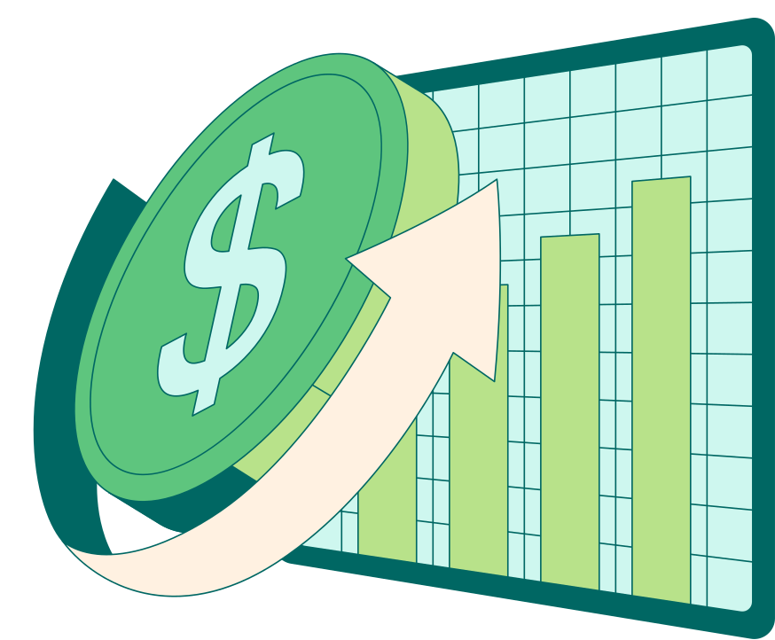

HOME
ABOUT
CONTENT
MESSAGE
@reallygreatsite
Descriptive Statistical Analysis
Population Data:
Calculate basic statistics (mean, median, mode, standard deviation) for population data across countries.
GDP Analysis:
Calculate the average GDP per capita by country and region.
Literacy Rates:
Calculate the average literacy rate across regions and countries.
Growth Trends:
Analyze growth trends for key variables (e.g., population, GDP) over time (1960-2017).

Slide 4

HOME
ABOUT
CONTENT
MESSAGE
@reallygreatsite
DAX Calculations
01
02
03
04
Calculating the population growth rate over time
Calculating the GDP growth rate
Creating calculated columns for GDP per capita
GDP data by region

Slide 5

HOME
ABOUT
CONTENT
MESSAGE
@reallygreatsite
Data Visualizations
Create a comprehensive dashboard that includes various visualizations such a
Bar charts, Line charts, Area charts, Pie
charts, Maps, etc.
Include filters and slicers for users to interact with the data.
Include important visualizations such as:
Population trends over time.
GDP per capita by country.
Population density by region.
Infant mortality and GDP correlation.

Slide 6
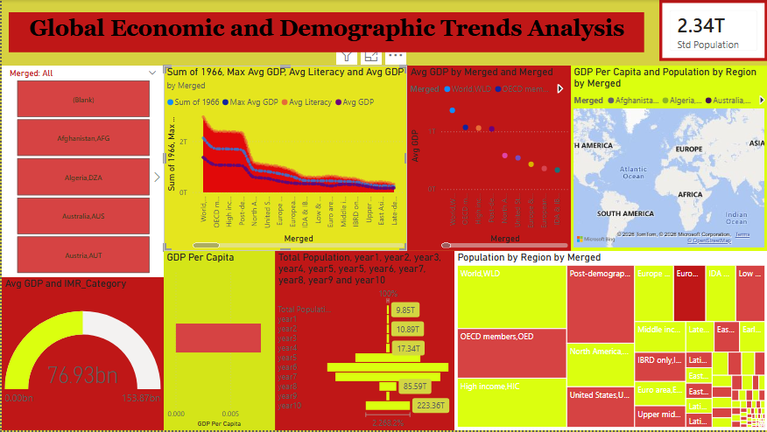
HOME
ABOUT
CONTENT
MESSAGE
@reallygreatsite

Slide 7
HOME
ABOUT
CONTENT
MESSAGE
@reallygreatsite
THANK YOU

